Slide 1
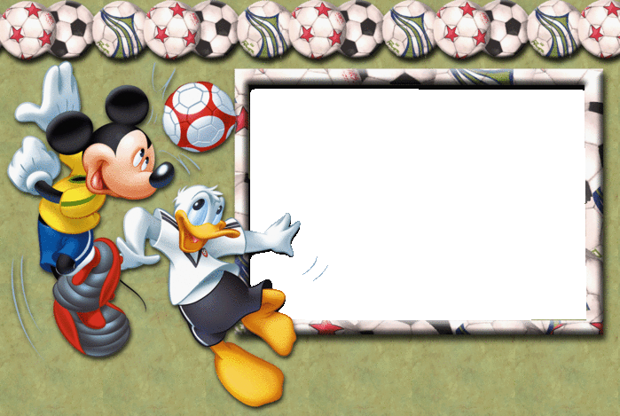
Интерактивный
кроссворд “Sport”
go

Slide 2

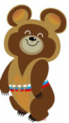
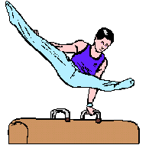
1
g
y
m
n
a
s
t
i
c
s
a sport in which you do
physical exercises on the
floor or on different
pieces of equipment,
often on competitions
?
go

Slide 3

2
s
w
i
1
g
y
m
n
a
s
t
i
c
s
m
i
n
g
sport in which sportsman must move in water in different styles
?
go

Slide 4
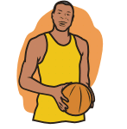
2
s
w
33
i
b
1
g
y
m
n
a
s
t
i
c
s
m
s
i
k
n
e
g
t
b
a game in which two teams try to win points by throwing a ball through a hoop
a
?
l
l
go

Slide 5
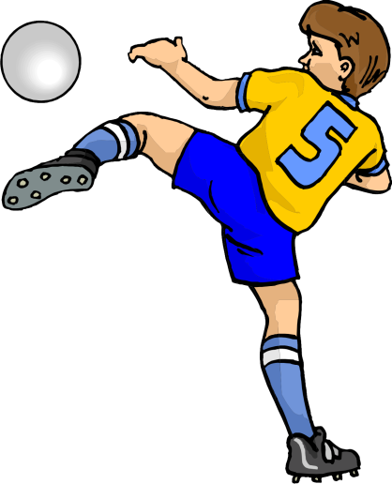
2
34
s
f
w
33
o
i
b
o
1
g
y
m
n
a
s
t
i
c
s
m
s
b
i
k
a
n
e
l
g
t
l
?
favourite sport in England
b
a
l
l
go

Slide 6
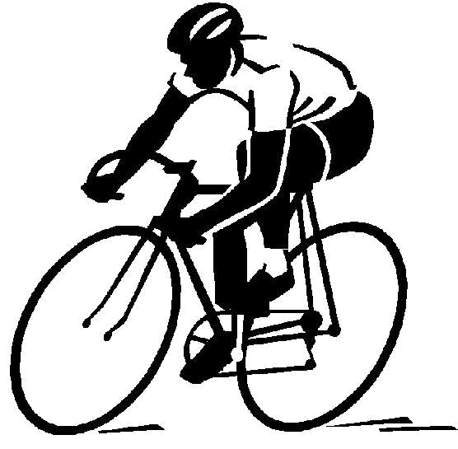
2
34
s
f
w
33
o
i
b
o
35
1
g
y
m
n
a
s
t
i
c
s
m
s
b
y
i
k
a
c
n
e
l
l
g
t
l
i
?
sport on two wheels
b
n
a
g
l
l
go

Slide 7
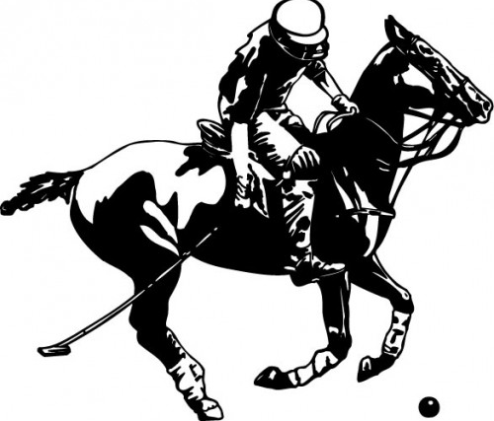
2
34
s
f
w
33
o
i
b
o
35
1
g
y
m
n
a
s
t
i
c
s
m
s
b
y
i
k
a
c
n
e
l
l
g
t
l
i
b
n
a game played between
two teams who ride horses and hit a ball with long, wooden
hammers
a
g
36
l
?
p
o
l
o
go

Slide 8
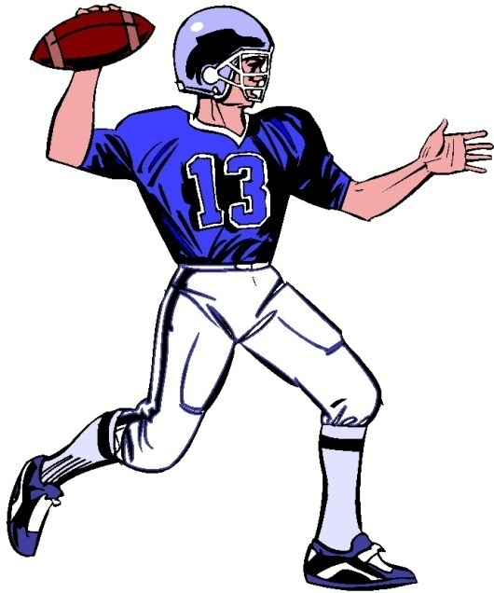
2
34
37
s
f
r
w
33
o
u
i
b
o
35
1
g
y
m
n
a
s
t
i
c
s
b
m
s
b
y
y
i
k
a
c
n
e
l
l
g
t
l
i
b
n
a sport played by two teams
with an oval ball and H-shaped
goals
a
g
?
36
l
p
o
l
o
go

Slide 9
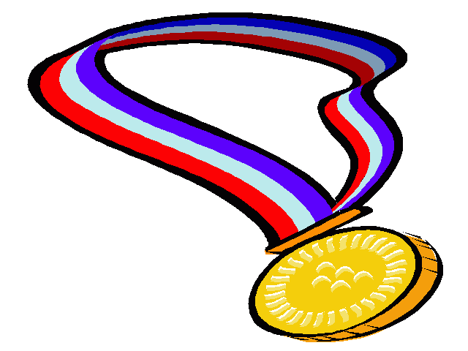
Well done!

Slide 10
Ресурсы: http://planeta-maek.ru/kid/animals/panda?jsp=9ca09e5791432759 Олимпийский Мишка http://ru.fotolia.com/id/25752594 поло
http://www.animaatjes.nl/cliparts/rugby/ регби
http://www.trabajadores.cu/20140214/se-siente-ya-la-primera-clasica-ciclistica-camaguey-la-habana велосипедист http://dir.coolclips.com/Sports/Competitive_Sports/Olympics/Summer/Gymnastics/Mixed гимнаст http://allforchildren.ru/pictures/basketball.php баскетбол
http://tr.fotolia.com/id/7678849 футболист
http://www.photo-dictionary.com/phrase/1319/medal.html медаль

